Slide 1
進度報告
Anti-spoofing

Slide 2
Attack 前情提要
Attack對象設定
只跑label是spoof且被test判別為spoof的frame
real被test判別為spoof的不會進行攻擊
Type 1:
Attack_success: Logit_real >= Logit_spoofing
Type 2:
Attack_success: Logit_real > Logit_spoofing

Slide 3
FGSM

Slide 4
OULU
Model
acc_mean | apcer | bpcer | acer
0.9591 | 0.1512 | 0.0128 | 0.0820
Attack
epsilon | type | ASR(%) | Attack Success | Attack Fail | Test Real
0.3 | 1 | 0.9202 | 415 | 36 | 17
0.3 | 2 | 0 | 0 | 451 | 17
0.4 | 1 | 0.9977 | 450 | 1 | 17
0.4 | 2 | 0 | 0 | 451 | 17
0.5 | 1 | 0.9977 | 450 | 1 | 17
0.5 | 2 | 0 | 0 | 451 | 17

Slide 5
Replay Attack
Model
acc_mean | apcer | bpcer | acer
0.9479 | 0.1625 | 0.03 | 0.09625
Attack
epsilon | type | ASR(%) | Attack Success | Attack Fail | Test Real
0.3 | 1 | 0.172 | 62 | 298 | 40
0.3 | 2 | 0.172 | 62 | 298 | 40
0.5 | 1 | 0.2917 | 105 | 255 | 40
0.5 | 2 | 0.2917 | 105 | 255 | 40

Slide 6
iFGSM

Slide 7
OULU
Model
acc_mean | apcer | bpcer | acer
0.9591 | 0.1512 | 0.0128 | 0.0820
Attack
epsilon | type | ASR(%) | Attack Success | Attack Fail | Test Real
0.3 | 1 | 0.9091 | 410 | 41 | 17
0.3 | 2 | 0.5964 | 269 | 182 | 17

Slide 8
image

Slide 9
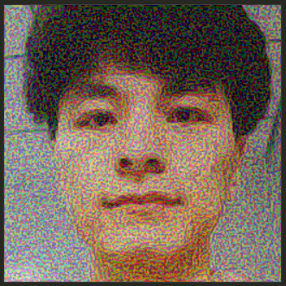
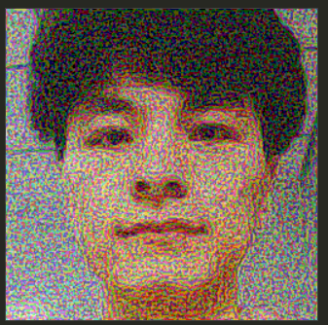


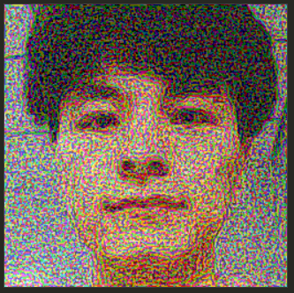
OULU
FGSM eps = 0.3
ASR = 0.9202
FGSM eps = 0.4
ASR = 0.9977
original
iFGSM eps = 0.3
ASR = 0.9091
FGSM eps = 0.5
ASR = 0.9977

Slide 10
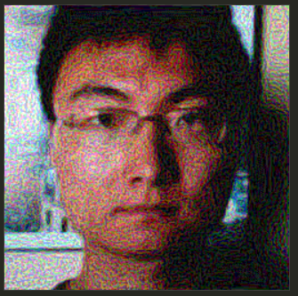
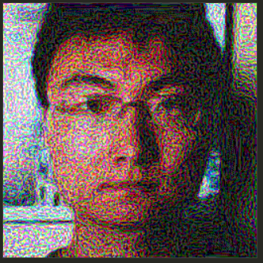

Replay Attack
FGSM eps = 0.3
ASR = 0.172
FGSM eps = 0.5
ASR = 0.2917
original

Slide 11
困難
FGSM
一堆[0.5 0.5]
Type1 : FGSM > iFGSM
Type2 : FGSM < iFGSM
Dataset
Replay attack難攻

